Slide 1
Plotly and Cufflinks
Module 02
Data Science Developer

Slide 2
Plotly
Plotly is a library that allows you to create interactive plots that you can use in dashboards or websites (you can save them as html files or static images).

Slide 3
Installation
In order for this all to work, you'll need to install plotly and cufflinks to call plots directly off of a pandas dataframe.
These libraries are not currently available through conda but are available through pip. Install the libraries at your command line/terminal using:
pip install plotly
pip install cufflinks

Slide 4
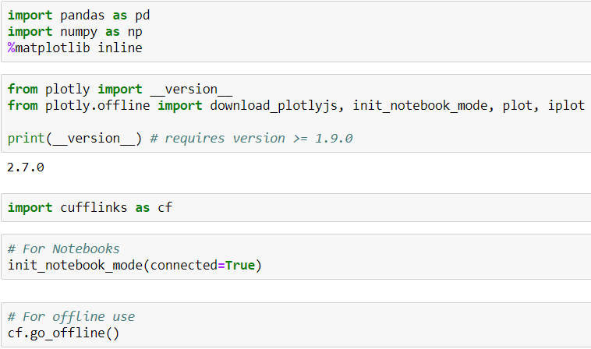
Imports and Set-up

Slide 5
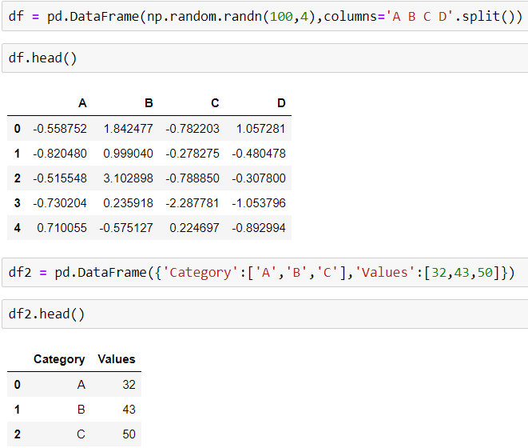
Data

Slide 6
Using Cufflinks and iplot()
scatter
bar
box
spread
ratio
heatmap
surface
histogram
bubble

Slide 7
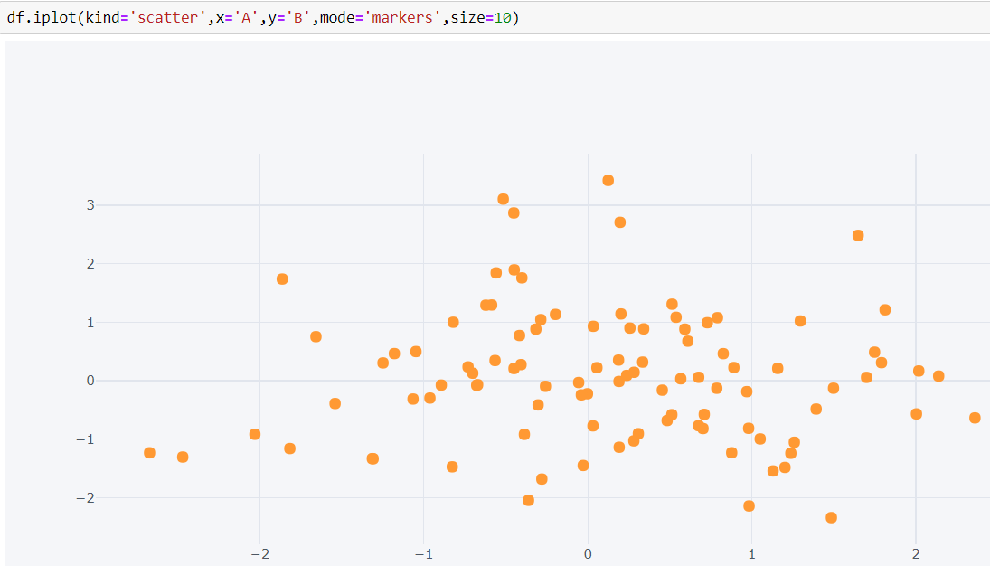
Scatter

Slide 8
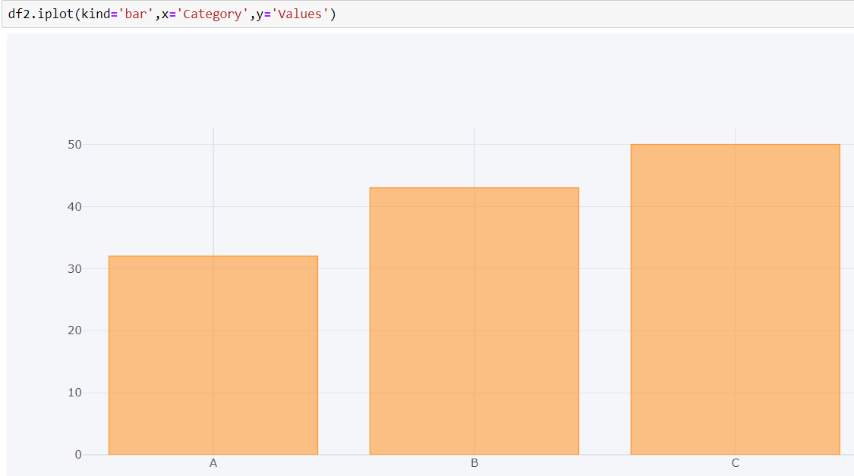
Bar Plots

Slide 9
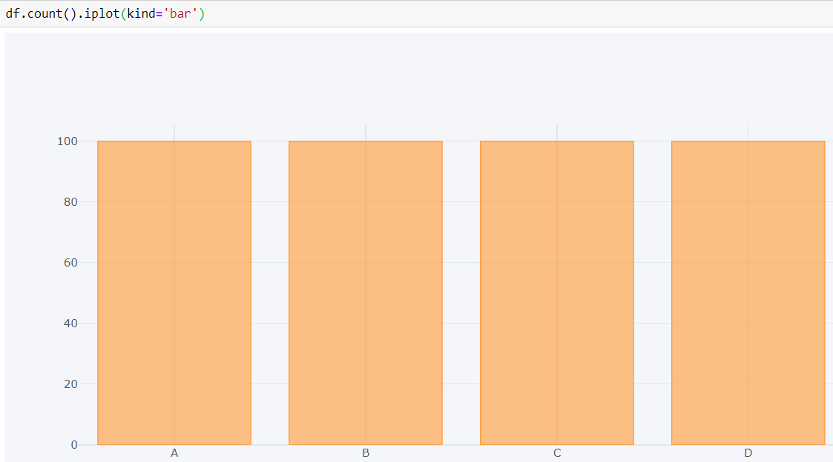

Slide 10
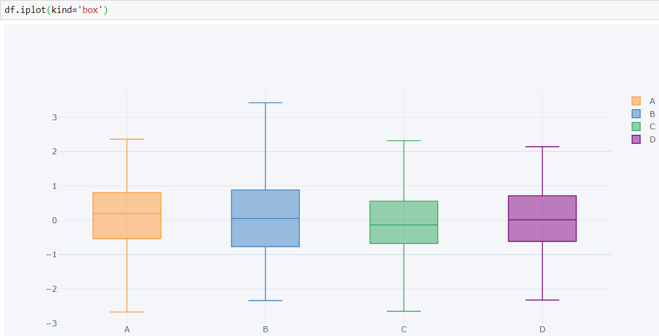
Boxplots

Slide 11
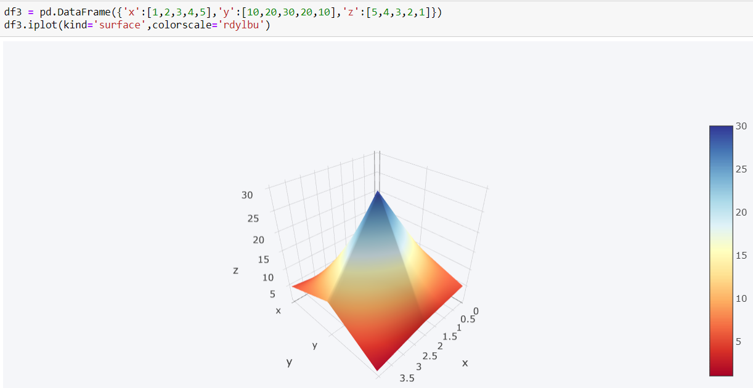
3d Surface

Slide 12
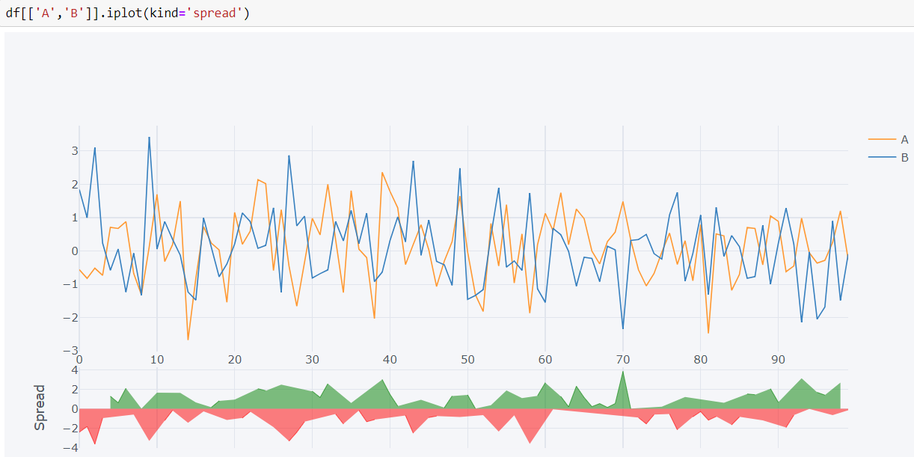
Spread

Slide 13
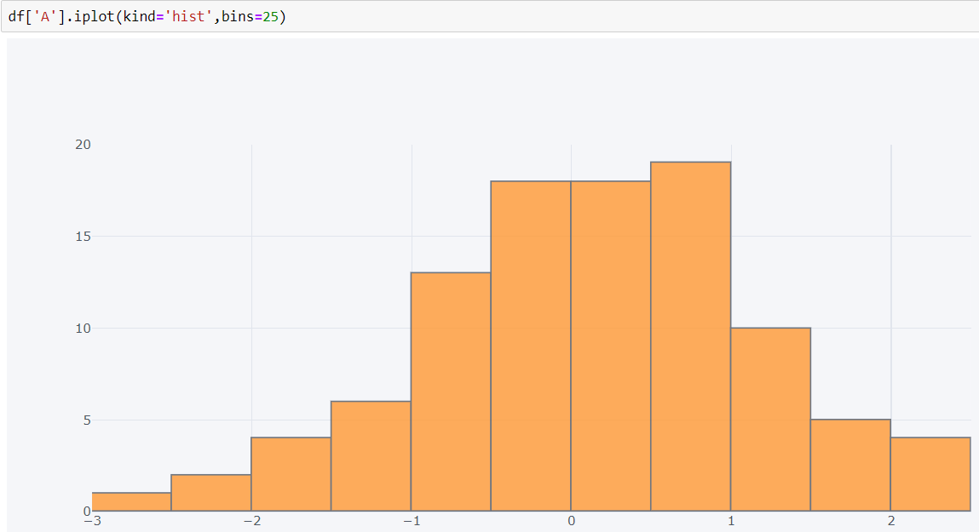
Histogram

Slide 14
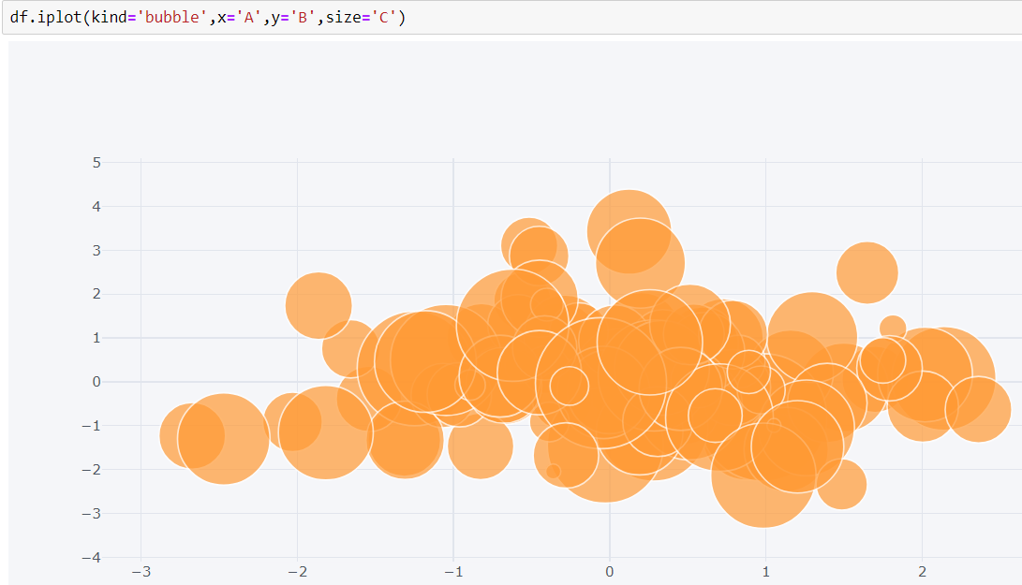
Bubble

Slide 15
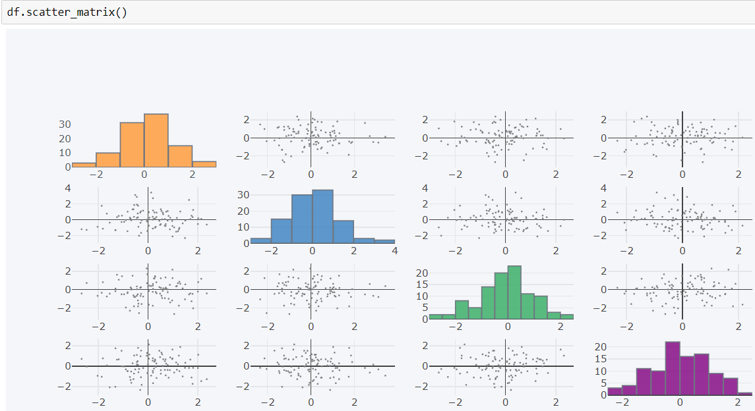
scatter_matrix()

